Slide 1
Technological transitioning to circular economy: mechanical engineering sector
Winter School “Sustainability in the Industrial Sector”
Cottbus, Germany – Dnipro, Ukraine
12th January 2021
Candidate of economic sciences, associate prof. Yuliia Dubiei,
student Nataliia Kruchinina

Slide 2
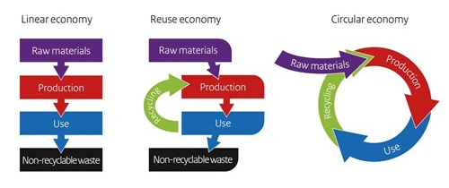
What is circular economy?
Current extractive industrial model
Transition from linear to circular economy
take, make and dispose
Circular economy model
restorative and regenerative by design
Key principles of circular economy
Preserve and enhance natural capital.
Optimise resource yields.
Foster system effectiveness by revealing and designing out negative externalities.
Sources: https://www.londonriversidebid.co.uk/news-and-events/the-circular-economy-resources-tools-and-information-for-small-businesses; Delivering the circular economy – a toolkit for policymakers. Ellen MacArthur Foundation. Available online at:https://www.ellenmacarthurfoundation.org/assets/downloads/publications/EllenMacArthurFoundation_PolicymakerToolkit.pdf
Cand. Sci. (Econ.) Yuliia Dybiei,
student Nataliia Krucninina // 12.01.2021

Slide 3
Moving towards the circular economy
Shift to renewable energy and materials.
Reclaim, retain, and restore health of ecosystems.
Return recovered biological resources to the biosphere.
Share assets (e.g. cars, rooms, appliances).
Reuse/secondhand.
Prolong life through maintenance, design for durability, upgradability, etc.
Increase performance/efficiency of product.
Remove waste in production and supply chain.
Leverage big data, automation, remote sensing and steering.
Remanufacture products or components.
Recycle materials.
Digest anaerobically.
Extract biochemicals from organic waste.
Dematerialise directly (e.g. books, CDs, DVDs, travel).
Dematerialise indirectly (e.g. online shopping).
Replace old with advanced non-renewable materials.
Apply new technologies (e.g. 3D printing).
Choose new product/service (e.g. multimodal transport).
Source: Delivering the circular economy – a toolkit for policymakers. Ellen MacArthur Foundation. Available online at: https://www.ellenmacarthurfoundation.org/assets/downloads/publications/EllenMacArthurFoundation_PolicymakerToolkit.pdf
Cand. Sci. (Econ.) Yuliia Dybiei,
student Nataliia Krucninina // 12.01.2021

Slide 4
Eco-Management and Audit Scheme (EMAS)
Current extractive industrial model
circular economy management
The Circular Economy tools and instruments
application of specific technologies and techniques
Circular economy model
The EU Eco-Management and Audit Scheme (EMAS) is a premium management instrument developed by the European Commission for companies and other organisations to evaluate, report, and improve their environmental performance.
Cand. Sci. (Econ.) Yuliia Dybiei,
student Nataliia Krucninina // 12.01.2021
Sources: https://ec.europa.eu/environment/emas/index_en.htm

Slide 5
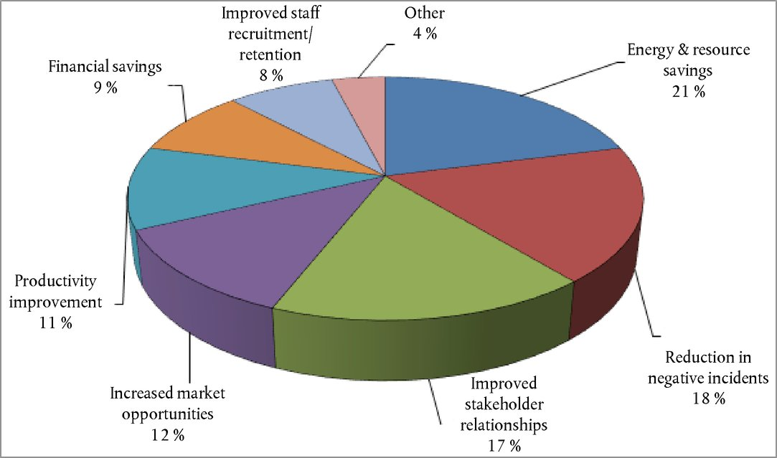
General information and benefits of EMAS
EMAS is a voluntary tool available to any organisation operating in any economic sector within or outside the European Union that wants to:
assume environmental and economic responsibility;
improve its environmental performance;
communicate its environmental results to society and stakeholders in general.
Benefits of implementing EMAS (% all responses)
Cand. Sci. (Econ.) Yuliia Dybiei,
student Nataliia Krucninina // 12.01.2021
Sources: https://eur-lex.europa.eu/legal-content/EN/TXT/?uri=celex%3A32017D2285#ntr22-L_2017328EN.01003902-E0022

Slide 6
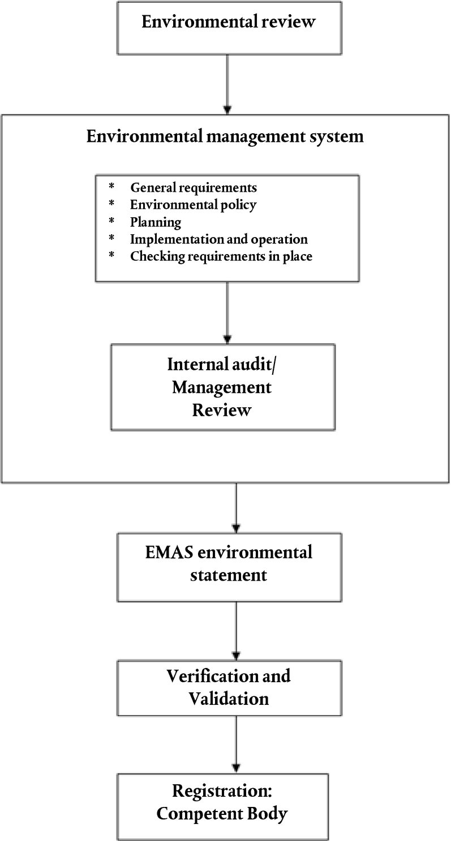
General schedule for EMAS implementation
Environmental Review
Relation between activities, environmental aspects and environmental impacts
Environmental aspects
Direct aspects
air emissions;
water emissions;
waste;
use of natural resources and raw materials;
local issues (noise, vibration, odours);
land use;
air emissions related to transport;
risks of environmental accidents and emergency situations.
Indirect aspects
product life cycle related issues;
capital investment;
insurance services;
administrative and planning decisions;
environmental performance of contractors, subcontractors and suppliers;
choice and composition of services e.g. transport, catering, etc.
Cand. Sci. (Econ.) Yuliia Dybiei,
student Nataliia Krucninina // 12.01.2021
Sources: https://eur-lex.europa.eu/legal-content/EN/TXT/?uri=celex%3A32017D2285#ntr22-L_2017328EN.01003902-E0022

Slide 7
Technological transitioning to circular economy in mechanical engineering sector
Mechanical engineering sector
Heavy engineering
Precision engineering
Medium engineering
Transport engineering
Metallurgical engineering
Mining engineering
Energy engineering
Agricultural and tractor engineering
Machine tool engineering
Equipment for light and food industry
Instrument engineering
Electrical engineering
Structure of mechanical engineering sector
Acoustical Engineering
Aerospace Engineering
Automotive Engineering
Control Systems Engineering
Mechanical engineering
Cybernetics
Heat Transfer
Mechatronics and Robotics
Marine Engineering
Structural Analysis
Transitioning to circular economy
Design and manufacturing issues
Digital technologies
Recycling & less energy consumption
Sources:https://www.dave4math.com/blog/what-is-mechanical-engineering/; http://osvita.ua/vnz/reports/geograf/23963/ ; The European machine tool sector and the circular economy. CECIMO Circular Economy Report, 2019. Available online at:
https://circulareconomy.europa.eu/platform/sites/default/files/circular_economy_report.pdf
Cand. Sci. (Econ.) Yuliia Dybiei,
student Nataliia Krucninina // 12.01.2021

Slide 8
Additive manufacturing
Additive manufacturing (AM), also known as 3D printing, is the general term used to refer to technologies that, based on a 3D digital model, build up parts by adding material layer by layer.
Example
machine tools
Benefits of implementation of AM in machine tools sector:
lightweight design and enhanced durability and functionality of components;
increasing material efficiency and recycling;
enabling on-demand and distributed manufacturing;
reparability and remanufacturing becomes easier and more cost-effective.
Additive Manufacturing can be a complement but not a substitute to subtractive manufacturing
Source: The European machine tool sector and the circular economy. CECIMO Circular Economy Report, 2019. Available online at:
https://circulareconomy.europa.eu/platform/sites/default/files/circular_economy_report.pdf
Cand. Sci. (Econ.) Yuliia Dybiei,
student Nataliia Krucninina // 12.01.2021

Slide 9
Digital technologies for circular economy
Technologies which enable getting real-time information about processes.
Digital twin.
Implementing predictive maintenance through digitalization.
Digital twin is a virtual model of a process, product or service, pairing virtual and physical worlds. This allows the analysis of data and monitoring of systems to develop new solutions or conduct predictive maintenance.
machine tools, aerospace
Example
Benefits of implementation of digital twin technology:
recognition of any behaviour deviations and influence on the development of future products;
reduction of the amount of testing and experiments of the products → more new products on the market in a short period of time; optimisation of products in advance, reduction of the resources used;
enabling of intelligent, machine-level decision-making at a factory level.
Barriers:
requirement of an up-to-date IT infrastructure;
high-quality training of employees of enterprises;
difficulties in implementation in small enterprises.
Sources: The European machine tool sector and the circular economy. CECIMO Circular Economy Report, 2019. Available online at:
https://circulareconomy.europa.eu/platform/sites/default/files/circular_economy_report.pdf ; Circular economy business models for the manufacturing industry. Circular Economy Playbook for Finnish SMEs. Available online at:
https://samfelagsabyrgd.is/assets/2020/05/circular-economy-playbook-for-manufacturing_v1-1.pdf; https://www.nec.com/en/global/insights/article/2020022510/index.html; https://industryeurope.com/building-a-digital-twin/
Cand. Sci. (Econ.) Yuliia Dybiei,
student Nataliia Krucninina // 12.01.2021

Slide 10
Recycling in mechanical engineering sector
Recycling is the collection, sorting and processing of disposed materials for use in other manufacturing processes.
vehicle recycling
Example
Obstacles for recycling:
used cars contain a number of harmful substances → special recycling technologies are required;
impossibility of recycling of metals that are corroded, rust;
the complexity of the design of some vehicles;
transportation costs and others.
Evaluation of the efficiency of vehicle recycling
, where
- recycling efficiency indicator (0,1 – 1);
- economic efficiency indicator of recycling;
- indicator of environmental importance of recycling;
!
There should be a predominance of materials which are easily recyclable: cast iron, welded steel and other metallic materials.
- indicator of the relative volume of intended recycling;
- the level of reuse in the national economy of parts obtained during disassembly of vehicles for recycling.
Sources: https://www.ipbcommunications.co.uk/recycling-commonsense-clear-simple-communications-key-cutting-waste/; https://www.ceguide.org/Strategies-and-examples/Dispose/Recycling; https://dspace.khadi.kharkov.ua/dspace/handle/123456789/1708; https://www.mountainwaste.com/solutions/recycling/challenges/; The European machine tool sector and the circular economy. CECIMO Circular Economy Report, 2019. Available online at: https://circulareconomy.europa.eu/platform/sites/default/files/circular_economy_report.pdf
Cand. Sci. (Econ.) Yuliia Dybiei,
student Nataliia Krucninina // 12.01.2021

Slide 11
Mechanical engineering sector in Ukraine
Development of mechanical engineering industries in Ukraine in 2017-2019
21 %
18 %
24 %
33%
Computers, electronic and optical products
Electrical equipment
Metal forming machinery and machine tools
Motor vehicles
Sources: http://www.ukrstat.gov.ua/; article ‘Influence of technological transformation on sustainable development of Ukrainian machine-building enterprises’, Yu.V. Dubiei
Cand. Sci. (Econ.) Yuliia Dybiei,
student Nataliia Krucninina // 12.01.2021

Slide 12
Barriers to the introduction of a circular economy in the mechanical engineering sector in Ukraine
Barriers in Ukraine
Opportunities for development / experience of other countries
Using of outdated equipment and technologies
Replacing equipment with a more modern one, which will allow the implementation of the basic principles of the circular economy: reducing the amount of resources used, recycling, etc.; advanced software for process optimisation; digitalisation; 3D-printing
Lack of qualified personnel
Low investment attractiveness of Ukrainian machine-building enterprises
Internal barriers on the enterprise
Market barriers
Institutional, regulatory and social barriers
Participation of enterprises in the system of specialized education, advanced training and retraining of personnel
The state should stimulate enterprises to increase their level of competitiveness and provide state-owned enterprises with updated equipment and highly qualified personnel
Technological modification of production systems, application of elements of the digital economy → enterprises can become more attractive for investments
Implementation of new organizational competences (e.g., team motivation, organizational culture, participation)
Measures within the policy and management of the enterprise, providing an increase in the indicators in the direction of production cooperation of industrial enterprises
Sources: Article ‘Influence of technological transformation on sustainable development of Ukrainian machine-building enterprises’, Yu.V. Dubiei; article ‘Overcoming the main barriers of circular economy implementation through a new visualization tool for circular business models’, Augusto Bianchini , Jessica Rossi and Marco Pellegrini; available online at: https://cris.unibo.it/retrieve/handle/11585/707028/508808/sustainability-Circular%20economy-%20Bianchini.pdf
Cand. Sci. (Econ.) Yuliia Dybiei,
student Nataliia Krucninina // 12.01.2021

Slide 13
Conclusion
!
The mechanical engineering sector has a significant impact on the ecological, economic, social environment → the issue of compliance of enterprises with the principles of sustainability and circular economy is very relevant.
!
In the direction of introducing a circular economy, there are barriers concerning both management at enterprises and their technological base.
!
Initiatives both from the enterprises of the mechanical engineering sector and from the state are needed to overcome the barriers.
Cand. Sci. (Econ.) Yuliia Dybiei,
student Nataliia Krucninina // 12.01.2021

Slide 14
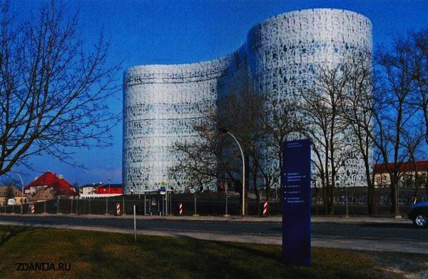
Winter School
“Sustainability in the Industrial Sector”
Technological transitioning to circular economy: mechanical engineering sector
Cand. Sci. (Econ.) Yuliia Dybiei,
student Nataliia Krucninina // 12.01.2021

