Slide 1
Department of System Analysis and Control
Faculty of Information
Technology
49005 Dnipro, av. Dmytra Yavornytskoho, 19
http://www.nmu.org.ua/en/
Research and development of complex objects and systems in the field of humanitarian, social, natural and technical sciences.

Slide 2
Dnipro University of Technology
Students over 10 000
Teachers 771
Graduation specialties 53
Institutes 4
Faculties 9
Departments 52
Scientific councils 7
International partners 118
77 Undergraduate courses
30 Postgraduate courses
13 Doctoral courses
According to the national rating “Top 200 Ukraine 2019 in Ukraine-2019” Dniorotech takes:
4th place among technical universities.
8th place among higher educational institutes.
Entered the ratings QS EECA, “top 50 Ukrainian HEE according to employers” from magazine “Focus”

Slide 3
System analysis and control department http://sau.nmu.org.ua/en/index.php
was founded in 1971.
carries out preparation of bachelors and masters of direction "System Analysis“ since 1999.
The educational process is provided by
4 professors, 3 doctors of sciences;
8 associate professors (4 Phd in physics and mathematics, 4 Phd in technical sciences);
4 experienced assistants.

Slide 4
Scientific Direction
Applicating of artificial intelligence methods to solving industrial problems in metallurgy and mining;
Optimal control of systems with distributed parameters. Approximation of Optimization Problems for Ill-Posed Nonlinear Elliptic Systems;
Research of stability and stabilization of unsteady rotation of a rigid body with fluid, modeling of complex systems;
Optimal two-stage allocation of material flows in a transport-logistic system with continuously distributed resource;
Mathematical modeling and methods for solving problems of optimal multiplex partitioning of sets;
Development of the adversarial attack algorithms.
Department of System Analysis and Control

Slide 5
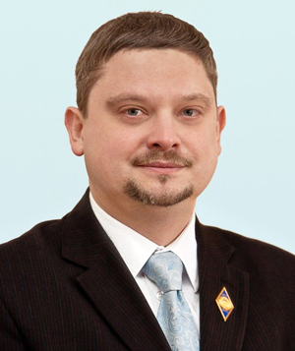
Evolutionary methodology used to manage, optimize production processes and forecasting in metallurgy
Provided by Timur A. Zheldak, associated professor, Phd inTechnical sciences
Problems solved:
Task scheduling of orders in a wide range of products
The task of optimizing the charge in the BOF production
The task of restoring the functions of mathematical models of steel deoxidation and certification of finished products
Two-stage task of optimum cutting of billets of rolling production
The problem of predicting the stability of the converter lining
Ingot weight optimization problems due to the flow of the process in future cutting
Pages and Contacts:
https://orcid.org/0000-0002-4728-5889
http://www.researcherid.com/rid/E-9761-2019
https://scholar.google.com.ua/citations?hl=uk&user=mFvgN9UAAAAJ zheldak.t.a@nmu.one

Slide 6
Evolutionary methodology used to manage, optimize production processes and forecasting in metallurgy
Main methods:
Group method of data handling (GMDH)
Ant colony optimization (ACO, ASC, MMAS)
Method of simulating artificial immune systems (HIMO, HISF, AiNET)
Real numerical coding genetic algorithm (RCGA)
Rules-based expert systems (ExSys)
Fuzzy-logic nets and decision making systems (ANFIS, Mamdani, Takagi-Sugeno)
The main publications for this study:
http://nbuv.gov.ua/UJRN/Nvngu_2016_5_24 .
http://nbuv.gov.ua/j-pdf/Nvngu_2013_1_16.pdf
https://www.academia.edu/10576535/Knowledge-Based_Intellectual_DSS_of_Steel_Deoxidation_in_BOF_Production_Process
https://www.academia.edu/10567334/Using_an_Evolutionary_Heuristics_for_Solving_the_Outdoor_Advertising_Optimization_Problem

Slide 7
Approximation of Optimization Problems for Ill-Posed Nonlinear Elliptic Systems
Provided by Olha P. Kupenko, Full Prof., Doctor of Physical and Mathematical Sciences
Object of Investigation is a class of optimization problems for systems that are described by nonlinear elliptic equations and variational inequalities whose non-smooth, singular, and degenerate coefficients in the principle part of an elliptic operator are adopted as controls.
Subject of Investigation is an analysis of qualitative properties of a wide class of optimization problems for ill-posed elliptic systems, whose coefficients have a singular character and are adopted as controls. In particular, it is the study of solvability, attainability of optimal solutions to such problems via optimal solutions of some regularized problems, stability of considered optimization problems with respect to domain perturbations, as well as deriving and substantiation of optimality conditions to optimization problems associated with nonlinear elliptic equations.

Slide 8
Approximation of Optimization Problems for Ill-Posed Nonlinear Elliptic Systems
Physical Example. Let us give an example of a physical process where the optimization problem in coefficients of an elliptic system appears as a mathematical model. We consider an anisotropic body $Ω⊂ℝ^{N}$ whose heat conductivity is described by a matrix of positive coefficients$𝒰={[a_{ij}\left(x\right)]}_{1≤i,j≤N}$, supposing the density of heat source $f∈L^{2}(Ω)$ and desired temperature distribution $z_{∂} ∈L^{2}(Ω)$ in the body $Ω$ are given. Due to the heat conservation law, it can be shown that an established temperature y(x) in $Ω$ satisfies the following elliptic Dirichlet problem
$−div(𝒰\left(x\right) ∇ y\left(x\right)=f$ in $Ω$, $y=0$ on $∂Ω$. (1)
If we put forward an objective to find a heat-conductivity matrix $𝒰_{opt}$ such that the corresponding temperature $y_{opt}(x)$ in $Ω$ is as close to the desired one $z_{∂}$ as possible, where the closeness is understood in the sense of $L^{2}(Ω)$-norm, than the mathematical model of the considered problem can be recovered as follows: to minimize the value of the cost functional
$I\left(𝒰,y\right)= \int_{Ω}{{|y−z_{∂}|}^{2} dx →inf}$. (2)
Mentioned above problem is close to the so-called inverse problem, which aims to determine certain physical properties of the body and its location through some remote-sensed parameters data. Due to the opportunity to determine material properties and parameters of various physical processes through mathematical calculations without carrying out any physical experiments, inverse problems found their wide applications in metallurgy, medicine, biology, ecology, space reconnaissance, etc. On the other side, enormous mathematical interest was triggered by the fact that majority of such problems are ill-posed in Hadamard sense.

Slide 9
References
[1] Kogut P. I. Optimal control problems in coeﬃcients for nonlinear Dirichlet problems of monotone type: Optimality conditions. Part I / P.I. Kogut, O.P Kupenko, G. Leugering // Z. Anal. Anwend. — 2015. — Vol. 34. — – 1. — P. 85–108, DOI: 10.4171/ZAA/1530.
[2] Kogut P. I. Optimal control problems in coeﬃcients for nonlinear Dirichlet problems of monotone type: Optimality conditions. Part II / P.I. Kogut, O.P Kupenko, G. Leugering // Z. Anal. Anwend. — 2015. — Vol. 34. — – 2. — P. 199–219, DOI: 10.4171/ZAA/1536.
[3] Kupenko O. P. On Existence and Attainability of Solutions to Optimal Control Problems in Coeﬃcients for Degenerate Variational Inequalities of Monotone Type / O.P. Kupenko // Continuous and Distributed Systems, Series: Solid Mechanics and Its Applications 211, Springer, 2013, DOI: 10.1007/9783-319-03146-0, P. 287–301.
[4] Kupenko O. P. On Existence of Weak Optimal Controls in Coeﬃcients for Degenerate Anisotropic pLaplacian / O.P. Kupenko, G. Leugering // Continuous and Distributed Systems II, 2015. — P. 315–337, doi:10.1007/978-3-319-19075-4 19.
[5] Kupenko O. P. On Optimality Conditions for Optimal Control Problem in Coeﬃcients for ∆p-Laplacian / O.P. Kupenko, R. Manzo// Boundary Value Problems (BVP). — 2014. — Vol. 72. — P. 1–29. http://www.boundaryvalueproblems.com/content/2014/1/72.
[6] Kupenko O. P. Optimal Control Problems in Coeﬃcients for Coupled System of Hammerstein Type / O.P. Kupenko, R. Manzo // DCDS, series B. — 2015. — Vol. 20. — – 9. — P. 2967–2992.
[7] Kupenko O. P. Approximation of an optimal control problem in coeﬃcient for variational inequality with anisotropic p-Laplacian / O.P. Kupenko, R. Manzo // Nonlinear Diﬀerential Equations and Applications. — 2016. — Vol. 23. — – 3. — DOI: 10.1007/s00030-016-0387-9.
[8] Durante T. On attainability of optimal controls in coeﬃcients for system of Hammerstein type with anisotropic p-Laplacian Laplacian / T. Durante, O.P. Kupenko, R. Manzo // Ricerche di Matematica. — 2016. — – 6, DOI: 10.1007/s11587-016-0300-1.
[9] Kupenko O. P. On Optimal Controls in Coeﬃcients for Ill-Posed Non-Linear Elliptic Dirichlet Boundary Value Problems / O.P. Kupenko, R. Manzo // DCDS, Series B. — 2018. — Vol. 23. — – 4. — pp. 1363–1393. DOI: 10.3934/dcdsb.2018155
[10] Durante T. On optimal boundary control problem for a strongly degenerate elliptic equation / T. Durante, O.P. Kupenko, R. Manzo // Ricerche di Matematica. — 2020. — Vol. 33. — – 1. — pp. 63–88, DOI: 10.1007/s13163-019-00310-5

Slide 10
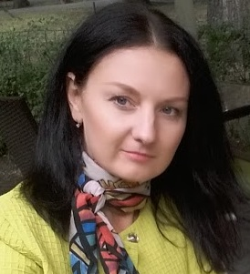
Research of stability and stabilization of unsteady rotation of a rigid body with fluid, modeling of complex systems
Provided by Tatyana V. Khomyak, associated professor, Сandidate of Physical and Mathematical Sciences
Object of Investigation is a Lagrange top with an axisymmetric cavity containing an ideal incompressible fluid.
Subject of Investigation is the problem of stability and passive stabilization of the unstable rotation of a Lagrange top with a fluid by means of rotating rigid bodies.
Research methods. Methods of analytical mechanics (Hamilton-Ostrogradsky principle) and modal analysis (equations of perturbed motion of a perfect rotating fluid) were used to obtain equations of motion of a system of elastically coupled rigid bodies with fluid. The conditions for the reality roots of the n degree equation are used, which are obtained by the innor method.

Slide 11
References
1. Khomyak T. V. Stabilization of the Unstable Spinning of a Lagrange Top Filled with a Fluid. International Applied Mechanics – 2015. – V.51, № 6, P. 702-709. (https://link.springer.com/article/10.1007/s10778-015-0728-0)
2. Khomyak T.V., Kononov Y.N. On the rotation stabilization of the unstable gyroscope containing fluid by rotating the rigid body. Facta Universitatis, Ser. Mech. Autom. Contr. Robotics, 4, No. 17, 195–201 (2005).
3. Khomyak T.V., Kononov Y.N. Stabilization by rotating rigid bodies for unstable rotation of a rigid body with cavities containing a fluid: Abstract and CD-ROM Proc. 21st Int. Congr. on Theoretical and Applied Mechanics (ICTAM-04), IPPT PAN, Warsaw, Poland (2004), p. 320.
4. Khomyak T.V., Kononov Y.N. Stabilization of the unstable spinning of a rigid body with a fluid by a rotating rigid body,” Visn. Donetsk. Univ., Ser. A, No. 2, 180–185 (2003).
5. Khomyak T.V., Kononov Y.N. Stabilization of the unstable free motion of a rigid body with a fluid by rotating rigid bodies: Proc. 3rd Belarus. Congr. on Theoretical and Applied Mechanics, OIM, Minsk, October 16–18 (2007), pp. 332–337.

Slide 12
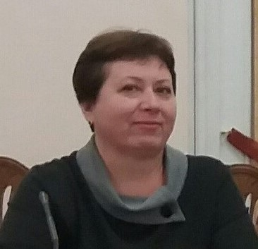
Optimal two-stage allocation of material flows in a transport-logistic system with continuously distributed resource
Provided by Svitlana A. Us, PhD in Physics and Mathematics, Professor;
Olha D. Stanina, Phd inTechnical sciences
The object of the research is a two-stage process of material flows allocation in the transport-logistic system, the structural elements of which are enterprises that collect a resource, is been distributed in a certain territory (centers of the first stage), and the enterprises that consume or process this resource.
Objective. The goal of the work is to ensure the reduction of transport costs in the organization of multi-stage production, the raw material resource of which is distributed in some territory, through the development of appropriate mathematical apparatus and software.

Slide 13
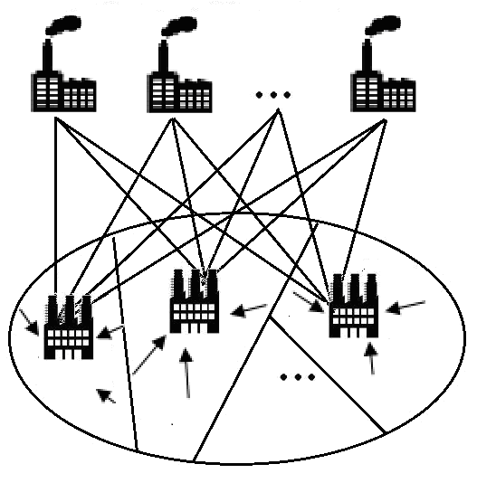
Two-stage transport problem with continuously distributed resource
further processing points
(enterprises of the 2 nd stage)
initial processing points
(1st stage enterprise)
Problem. It is necessary to find the location coordinates of the first-stage centers in a given territory, determine the service areas of these centers for the collection of raw materials and distribute the preliminary sorted raw materials between the centers of the second stage minimizing total transport costs.
resource

Slide 14
Application areas
rational collection of agricultural crops and their delivery first to the granaries, and then to the end user;
forming a network of modern waste transfer stations and waste sorting stations to reduce the specific total costs for the export of waste;
planning of logging operations and subsequent removal of timber with the organization of intermediate warehouses, taking into account not only the specific plots being developed, but also the possibility of using pile sites for delivering timber to them from neighboring felling areas;
distribution of materials flows between customers, points of receipt and processing of raw materials, ensuring minimum transportation costs;
formation of a regional warehouse network, net of a postal delivery services.

Slide 15
Spesific features of the task
the resource, that is collected and transported, is continuously distributed throughout the specified area;
the location of the first stage enterprises may be known in advance or not;
capacities of the the first stage enterprises can be set in advance or they will have been determined by the amount of raw materials collected in their corresponding zones
Methods. The theory of continuous linear problems of optimal set partitioning, duality theory, and methods for solving linear programming problems of transport type.

Slide 16
Two-stage transport problem with continuously distributed resource
Problem А. To find such partition of set $Ω$ into disjoint subsets $\bar{ω}=\{Ω_{1},Ω_{2},...,Ω_{N}\}$ (some of which can be empty), to determine coordinates of its centers $τ_{1}^{I},...,τ_{N}^{I}$ and supply volumes $v_{11},...,v_{NM}$, under which the functional
$F(\bar{ω},τ^{I},ν)=\sum_{i=1}^{N}{\int_{Ω_{i}}{c_{i}^{I}(x,τ_{i}^{I})}ρ(x)dx}+$ $\sum_{i=1}^{N}{\sum_{j=1}^{M}{\left(c_{ij}^{II}(τ_{i}^{I},τ_{j}^{II})+a_{i}\right)}}v_{ij}$ (1)
would have reached a minimum value, and the following conditions were satisfied:
$\int_{Ω_{i}}{ρ(x)dx}=\sum_{j=1}^{M}{v_{ij}}$, $i=\overline{1,N}$, (2)
$\sum_{i=1}^{N}{v_{ij}}=b_{j}^{II}$, $j=\overline{1,M}$, (3)
$\bar{ω}∈Σ_{Ω}^{N}$, $ν∈R_{NM}^{+}$, $τ^{I}∈Ω^{N}$, (4)
$Σ_{Ω}^{N}=\left\{\bar{ω}=\left\{Ω_{1},…,Ω_{N}\right\}\right.: \bigcup_{i=1}^{N}{Ω_{i}}=Ω, \text{mes}\left(Ω_{i}∩Ω_{j}\right)=0,\left. i≠j, i, j=\overline{1,L}\right\}.$ (5)

Slide 17
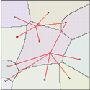
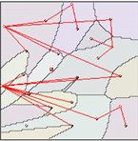
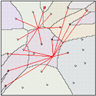
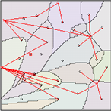
Optimal partition of set and communication scheme
М=2
М=5
N=10
N=18
N=25
N=25

Slide 18
References
An optimal two-stage distribution of material flow at the fuel and energy complex enterprises / B Blyuss, L Koriashkina, S Us, S Minieiev, S Dziuba - E3S Web of Conferences, 2019 / DOI https://doi.org/10.1051/e3sconf/201910900008
Zelentsov D., Us S., Koryashkina L., Stanina O. , Solving Continual Two-Stage Problems of Optimal Partition of Sets // International Journal of Research Studies in Computer Science and Engineering (IJRSCSE) / Volume 4, Issue 4, 2017, PP 72-80
Us S.A, Stanina O.D, The methods and algorithms for solving multi-stage location-allocation problem, Power Engineering and Information Technologies in Technical Objects Control, Balkema 2016, pp 163-172.
Us S.A, Stanina O.D, On some mathematical models of facility location problems of mining and concentration industry, Theoretical and Practical Solutions of Mineral Resources Mining, Balkema 2015, pp 419-424.

Slide 19
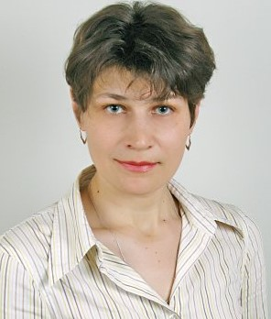
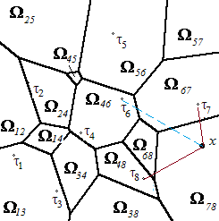
Mathematical modeling and methods for solving problems of optimal multiplex partitioning of sets
Provided by Larysa S. Koriashkina P. , PhD in Physics and Mathematics, associated professor and Antonina P. Cherevatenko, PhD in Technical Science, teaching assistant
Problem statement: It is required to find a partition of the limited set into subsets of points, each of which would correspond (in accordance with certain criteria) to the same set of k points from N, which are called centers (sites) (k<N).
Coordinates of centers can be either known or have to be determined along with partition.
The restrictions on power of subsets, possible places of centers’ location and other can be considered.

Slide 20
Examples of project results
а
b
Fig. 1. Optimal partitions of the second order of a disjoint set for nine centers in Minkowski metric with parameter p = 2 (a) and p = 1 (b)
Fig. 2. Optimal partition of the second order of a disjoint set for nine using data from GIS

Slide 21
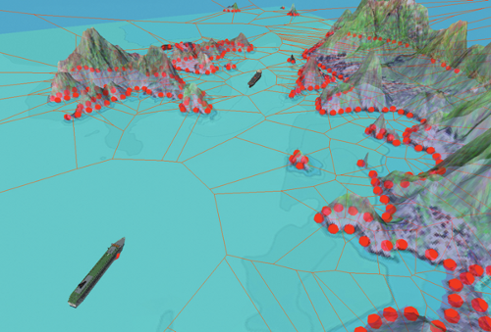
Practical applications
computer graphics,
geometric modeling,
pattern recognition and forms analysis,
maps segmentation,
geospatial data mining,
modeling of retail trade areas,
analysis of video frames content,
etc.

Slide 22
Koriashkina L.S. Continuous problems of optimal multiplex-partitioning of sets without constraints and solving methods / L.S. Koriashkina, А.Р. Cherevatenko // Journal of Computational & Applied Mathematics. — 2015. — N 2 (119). — P. 15–32.
Koriashkina L. The continuous problems of the optimal multiplex partitioning an application of sets / L. Koriashkina, A. Cherevatenko, O. Mykhalova // Power Engineering and Information Technologies in Technical Objects Control – Pivnyak, Beshta & Alekseyev (eds). — Taylor & Francis Group, London. — 2016. — P. 233–239.

Slide 23
Development of the adversarial attack algorithms
Provided by Larysa S. Koriashkina P. , PhD in Physics and Mathematics, associated professor and Kostiantyn Khabarlak, postgraduate student
The ongoing research in a direction of neural network inference understanding has led to a discovery coined as Adversarial Attack.
By adding a slight human-imperceptible perturbation to an input image, it has been made possible to fool the network and force it to misclassify the image as an instance of another class.
Such an attack has been further divided into 2 subgroups:
the non-targeted attack, when the new inference class is of no importance unless it’s different from the source;
the targeted attack, when we specify the target class we want the network to predict after the attack for a given image.

Slide 24
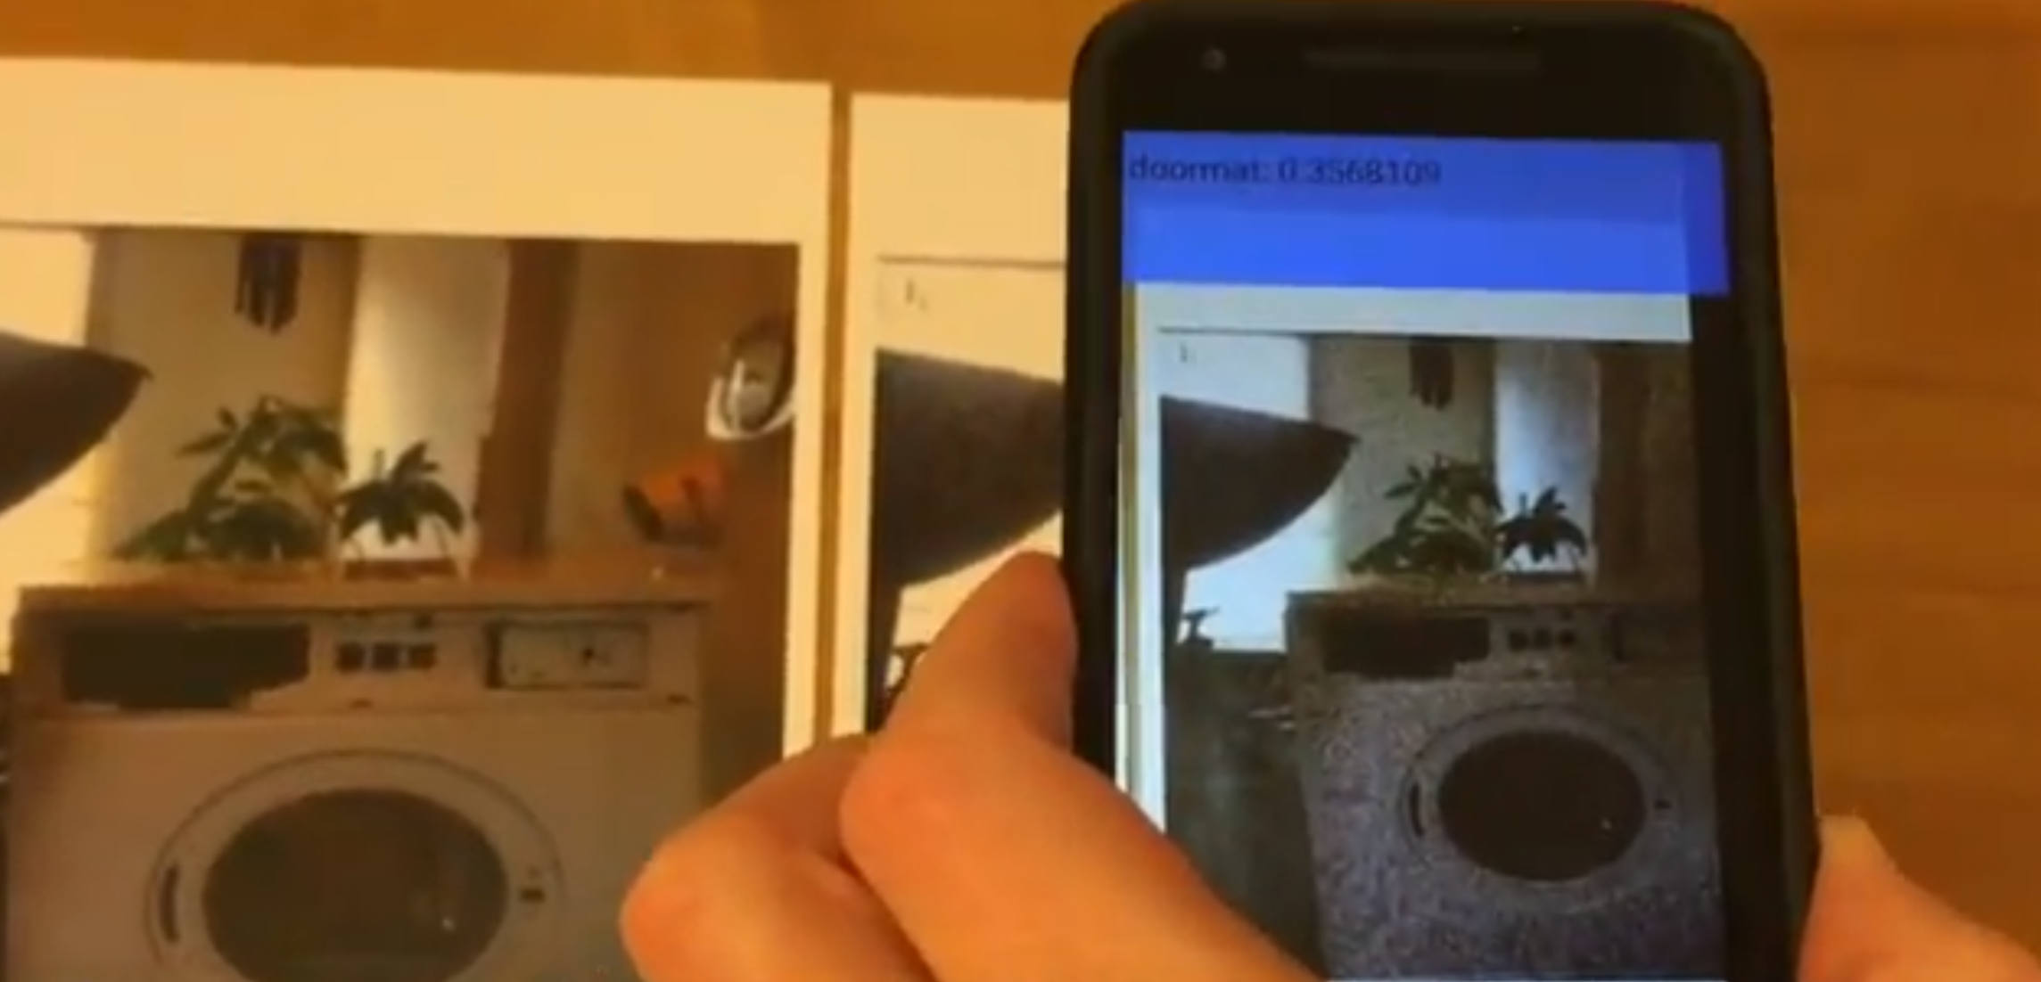
Problem statement: It is required to develop simplified adversarial attack algorithms based on a scoping idea, which
enables execution of fast adversarial attacks that minimize structural image quality (SSIM) loss,
allows performing efficient transfer attacks with low target inference network call count
opens a possibility of an attack using pen-only drawings on a paper for the MNIST handwritten digit dataset.
Floor mat
Adversarial examples in the physical world / A. Kurakin, I. Goodfellow, and S. Bengio. – 2016.

Slide 25
Adversarial attacks can be conducted in real-world
«Stop» – «Speed Limit 45»
Robust Physical-World Attacks on Deep Learning Models. / Kevin Eykholt, Ivan Evtimov, Earlence Fernandes, Bo Li, Amir Rahmati, Chaowei Xiao, Atul Prakash, Tadayoshi Kohno, Dawn Song. – 2018.

Slide 26
Practical application
Photo
Centering
Inversion
Prediction
Attack

Slide 27
Attacks performed with the help of the designed importance map are successful
4 (80%)
9 (42%)
0 (81%)
5 (100%)
9 (53%)
6 (56%)
5 (62%)

Slide 28
What was be used?
binary map of importance
Ability to write in only one color
Regularization of the algorithm’s parameter min_diffrence

Slide 29
Random perturbations without knowing vulnerable regions have no effect
3 (74%), 5(26%)
2 (98%)
Khabarlak. K, Koriashkina L. Minimizing Perceived Image Quality Loss Through Adversarial Attack Scoping – arXiv preprint arXiv:1904.10390
Khabarlak. K, Koriashkina L. Scoping Adversarial Attack for Improving its Quality – Radio Electronics, Computer Science, Control, 108-118 – 2019

Slide 30
Directions of student scientific work
Development of distributed client-server applications;
Development of expert systems;
Analysis and optimization of business processes of enterprises;
Conducting system analysis and development of DSS for making managerial decisions in the conditions of production enterprises;
The use of adaptive smoothing methods for predicting the performance of enterprises.

Slide 31
Dual degree programm
Problems
Differences in the schedule of the educational process;
Annual changes to the list of available courses
We need it by September or earlier to coordinate a curriculum before educational process will be start

Slide 32
Module Equivalents at the University of Koblenz-Landau and at the National Mining University
*
Modules and Study Units at the Uni KO-LD “Mathematical Modeling of Complex Systems” | Modules and Study Units at the National Mining University “System analyses and control”
Project seminar Project seminar | Industrial Practical Training Pre-Diploma Practical Training
Master thesis final oral exam | Master thesis final oral exam
Special topics of Applied Mathematics | Game Theory in the Conflict Situation Studies Special topics of Applied Mathematics
Numerics for Partial Differential Equations | Mathematic Modelling and Analysis Dynamic System
Integer Optimization | Methods of discreet optimization
Pattern Recognition | Machine Learning of Complex Systems
Machine Learning & Data Mining | Intellectual Data Analysis
Robotics and Computer Vision | Robotics and Computer Vision
Enterprise Architecture Modeling I | Enterprise Architecture Modeling

Slide 33
Comparative characteristic of the program modules
Course name |  | Numbers of credits | Course name | Numbers of credits
 | Obligatory modules 2017 |  | Obligatory modules 2019
 | Higher School Pedagogy | 3
 | Intellectual Property | 3
 | Philosophical Issues of Scientific Research | 3
 |  |  | English/German/French for Professional Purposes | 6
 | Labor Safety in the Branch | 3 | Security Management, Autonomy and Responsibility in Professional Activities | 3
 | Methodology of Scientific Research | 3 | Methodology of Scientific Research | 3
 | Game Theory in the Conflict Situation Studies | 5 | Game Theory in Conflict Situation Studies | 6
 | Intellectual Data Analysis | 6 | Intellectual Data Analysis | 6
 | Basics of Logistics | 6.5 | Basics of Logistics | 6
 | Industrial Practical Training | 6 | Industrial Practical Training | 8
 | Pre-Diploma Practical Training | 3 | Pre-Diploma Practical Training | 4
 | Master Thesis | 21 | Master Qualification Thesis | 18
 | Optional Compulsory Section |  | Optional Compulsory Section
 | Enterprise Economic Activity Analysis | 4
 | Integrated Management Systems | 7.5
 | Project Management | 5
 | Discrete Optimization Methods |  | Discrete Optimization Methods | 6
 | Mathematic Modelling and Analysis Dynamic System | 5 | Mathematic Modelling and Analysis Dynamic System | 6
 | Machine Learning of Complex Systems | 6 | Machine Learning of Complex Systems | 6
 | Enterprise Architecture Modeling | 6 | Enterprise Architecture Modeling | 6
 | Robotics and Computer Vision | 6 | Robotics and Computer Vision | 6

Slide 34
Students academic mobility
Proposels
Academic mobility for bachelor student, who know German
Dual supervisers of graduation projects ( master and bachelor)
holding summer schools
topics
organization of classes and excursions,
group work.
the opportunity to attract students from other specialties for academic mobility

Slide 35
Thank you for your attention

